Slide 1













COVID-19
Public Policy Observatory
for the Americas
In collaboration with :
June 2, 2020

Slide 2
Principal Investigators and Associates
Felicia Marie Knaul, University of Miami
Héctor Arreola-Ornelas, University of Miami
Michael Touchton, University of Miami
Thalia Porteny,Tufts University
Mariano Sánchez-Talanquer, Centro de Investigación y Docencia Económicas
Oscar Méndez Carniado, University of Miami
Pablo Kuri, UNAM
Sallie Hughes, University of Miami
Mariana Chudnovsky, Centro de Investigación y Docencia Económicas
Salomón Chertorivski, Centro de Investigación y Docencia Económicas
Website development and data vizualization:
Alberto Cairo, Kim Grinfeder, Lenny Martínez,
Raymond Balise, Layla Bouzoubaa, y Gerardo Perez Castillo
Research assistance
Sonia X. Ortega Alanís Marco Antonio Faganello Javier Dorantes Aguilar Salvador Acevedo Gómez Karen L. Luján López. L. Lizette González Gómez Ariel García Terrón

Slide 3

Latin America and Carib have 40% of daily global deaths.
Brazil has more that half of these deaths.
Daily deaths among patients diagnosed with COVID19 (7-day Rolling average)
Brazil
=23%
LatAm
=40%
4,069
global
deaths
USA
Europe
Apr 22
Apr 29
May 6
May 13
May 20
May 30
Source: FT analysis of data from the European Centre for Disease Prevention and Control and the Covid Tracking Project. Data updated May 31 2020

Slide 4
New deaths attributed to Covid-19:
Brazil, Mexico, Peru, Chile and Ecuador vs
US, India, Spain, China
Seven-day rolling average of new deaths, by number of days since 3 average deaths first recorded
2000
United States: 941
1000
Brazil: 950
500
México: 362
200
India
Perú
100
50
Chile
Spain
Colombia
Ecuador
20
Argentina
10
5
2
1
China
0
10
20
30
40
50
60
70
80
90
100
110
120
Source: FT analysis of data from the European Centre for Disease Prevention and Control and the Covid Tracking Project. Data updated May 31 2020

Slide 5
This Observatory provides daily data on public health and physical distancing policies implemented at the national and sub-national levels & on population mobility “avoided”, measured since the data of the first confirmed case of COVID-19 diagnosed in each country

Slide 6
Public Policy Index
We begin with the University of Oxford index (The Oxford COVID-19 Government Response Tracker v.5 (OxCGRT))
We include 10 public policy variables, conceptualized at the state level:
3) The sum and weight for the day each policy is implemented in relation to the first case (February 27), giving less weight to recent days vs. the first days.
    School closing
    Workplace suspension
    Cancellation of public events
    Suspension of public transit
    Information campaign development
    Domestic travel restriction
    International travel control
    The directive to stay home
    Restrictions on numbers of people in group gatherings
    The obligatory use of facemasks

Slide 7

Mobility Index
Using Google mobility data (Information on community mobility before Covid-19), we create the mobility index using a 7-day moving average of mobility
We rank from highest to lowest according to how much mobility is “avoided” referring to typical weeks before the pandemic
Orange is above normal mobility
Green area corresponds to accumulated mobility “avoided”
Date of
first case

Slide 8
Index of Public Policy, Latin America, Select countries, Observatory and Oxford
90
El Salvador
Perú
Guatemala
Bolivia
80
Paraguay
Argentina
Ecuador
Venezuela
Colombia
Panamá
60
C.
Rica
Chile
Uruguay
México Observatorio
40
Brazil Observatorio
20
Nicaragua
0
Febrero 27
Marzo 02
Abril 01
Mayo 01
Mayo 21
Note: Mexico and Brazil are state-sum Observatory data; rest are Oxford tracker

Slide 9
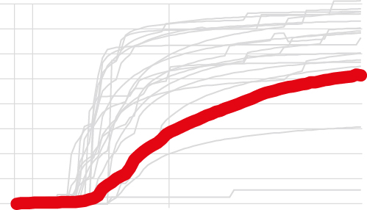
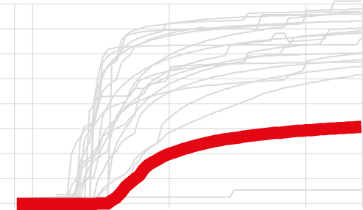
Index of Public Policy Adoption,
By country, cumulative rank order
El Salvador
Guatemala
Bolivia
Venezuela
Paraguay
90
0
Peru
Panama
Uruguay
Argentina
Ecuador
90
0
Colombia
Costa Rica
Dominican Republic
90
Note: Mexico and Brazil are state-sum Observatory data; rest are Oxford tracker
0
Mexico (Observatorio)
Brazil (Observatorio)
Nicaragua
90
0

Slide 10
Mobility Index, Latin America
(average mobility in the past 7 days compared to normal, pre-COVID)
10
Mobility pre-COVID
0
-10
-20
Nicaragua
-30
Brazil
-40
Mexico
-50
-60
El Salvador
-70
Peru
-80
Bolivia
-90
Feb
27
Mar
2
Apr
1
May
1
May
21
Source: Estimaciones propias con base en datos de Google del 27 de febrero al 21 de mayo de 2020.

Slide 11
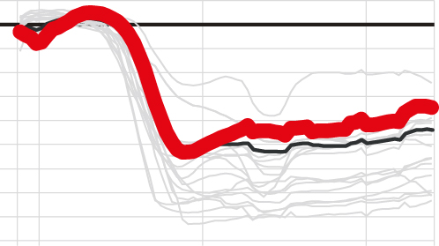
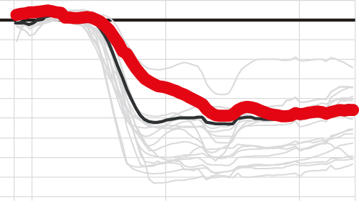
Mobility Index, By country
Cumulative rank order of avoided morality, high to low
(average mobility in the past 7 days compared to normal, pre-COVID)
Bolivia
Peru
Ecuador
Panama
El Salvador
0
-90
Argentina
Dominican Republic
Colombia
Chile
Paraguay
0
-90
Guatemala
Venezuela
Uruguay
Costa Rica
0
-90
Brazil
Mexico
Nicaragua
0
-90

Slide 12
Use of face masks, past 7 days, Source: IHME
80
Chile
Peru
Argentina
Ecuador
70
Colombia
Brazil
México
60
Percent always using masks
50
40
30
Apr 27
May 04
May 11
May 18
May 25

Slide 13
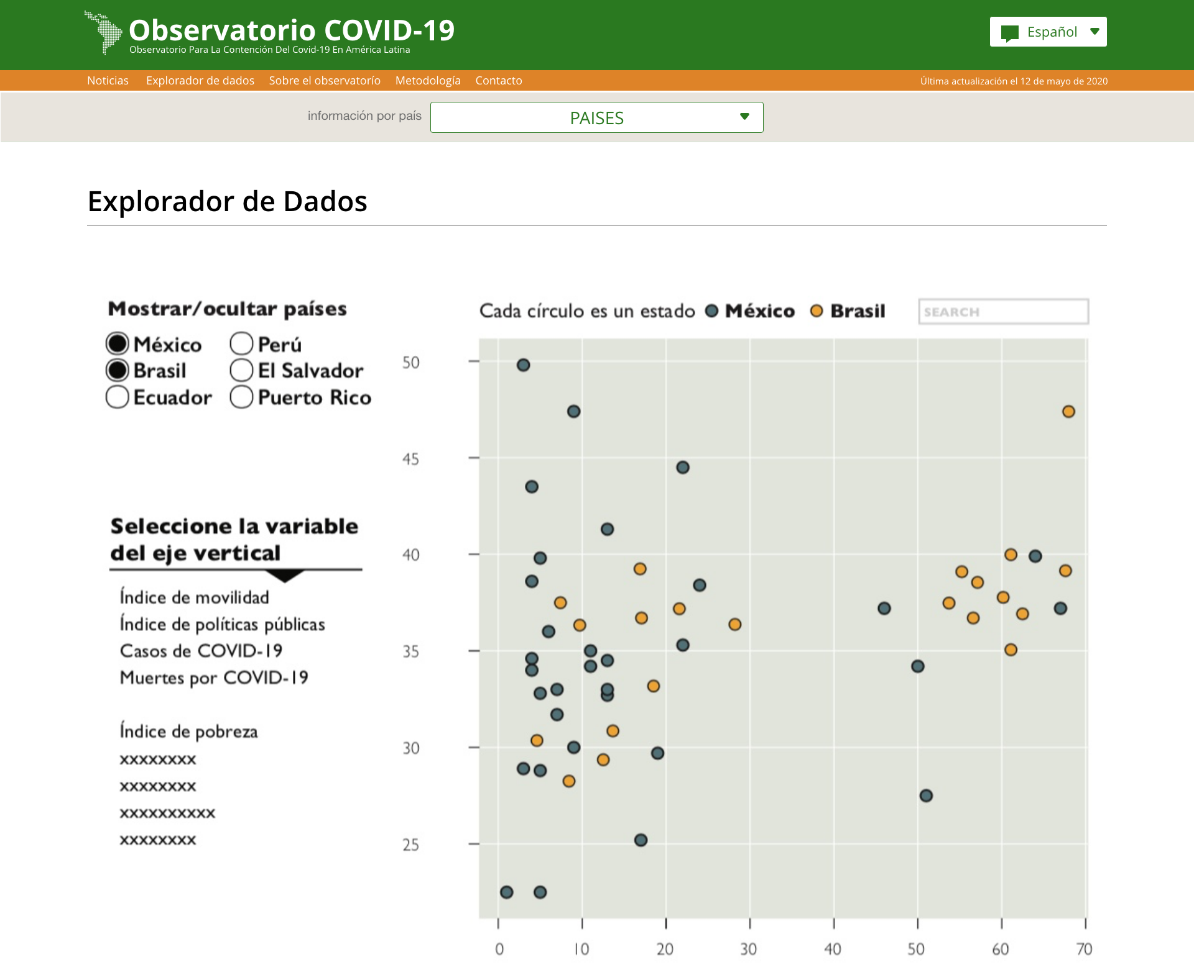
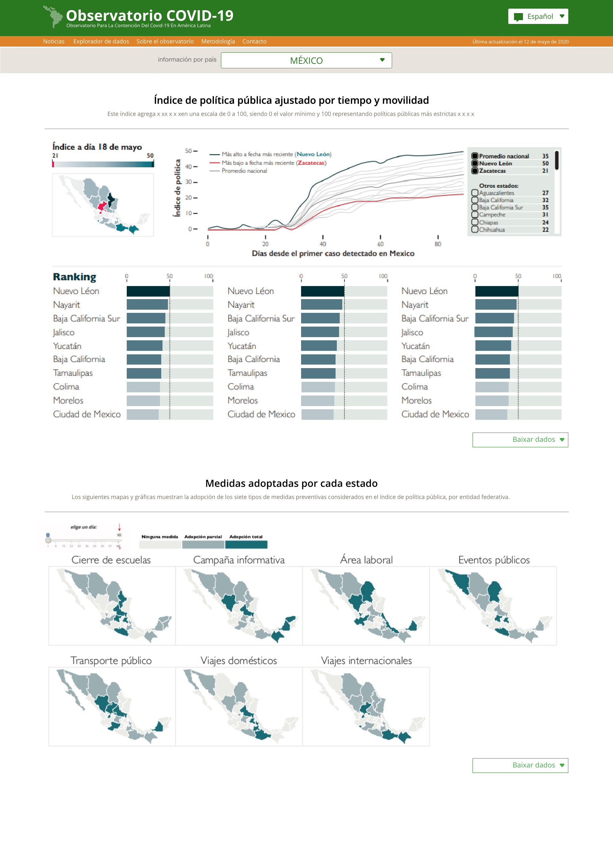
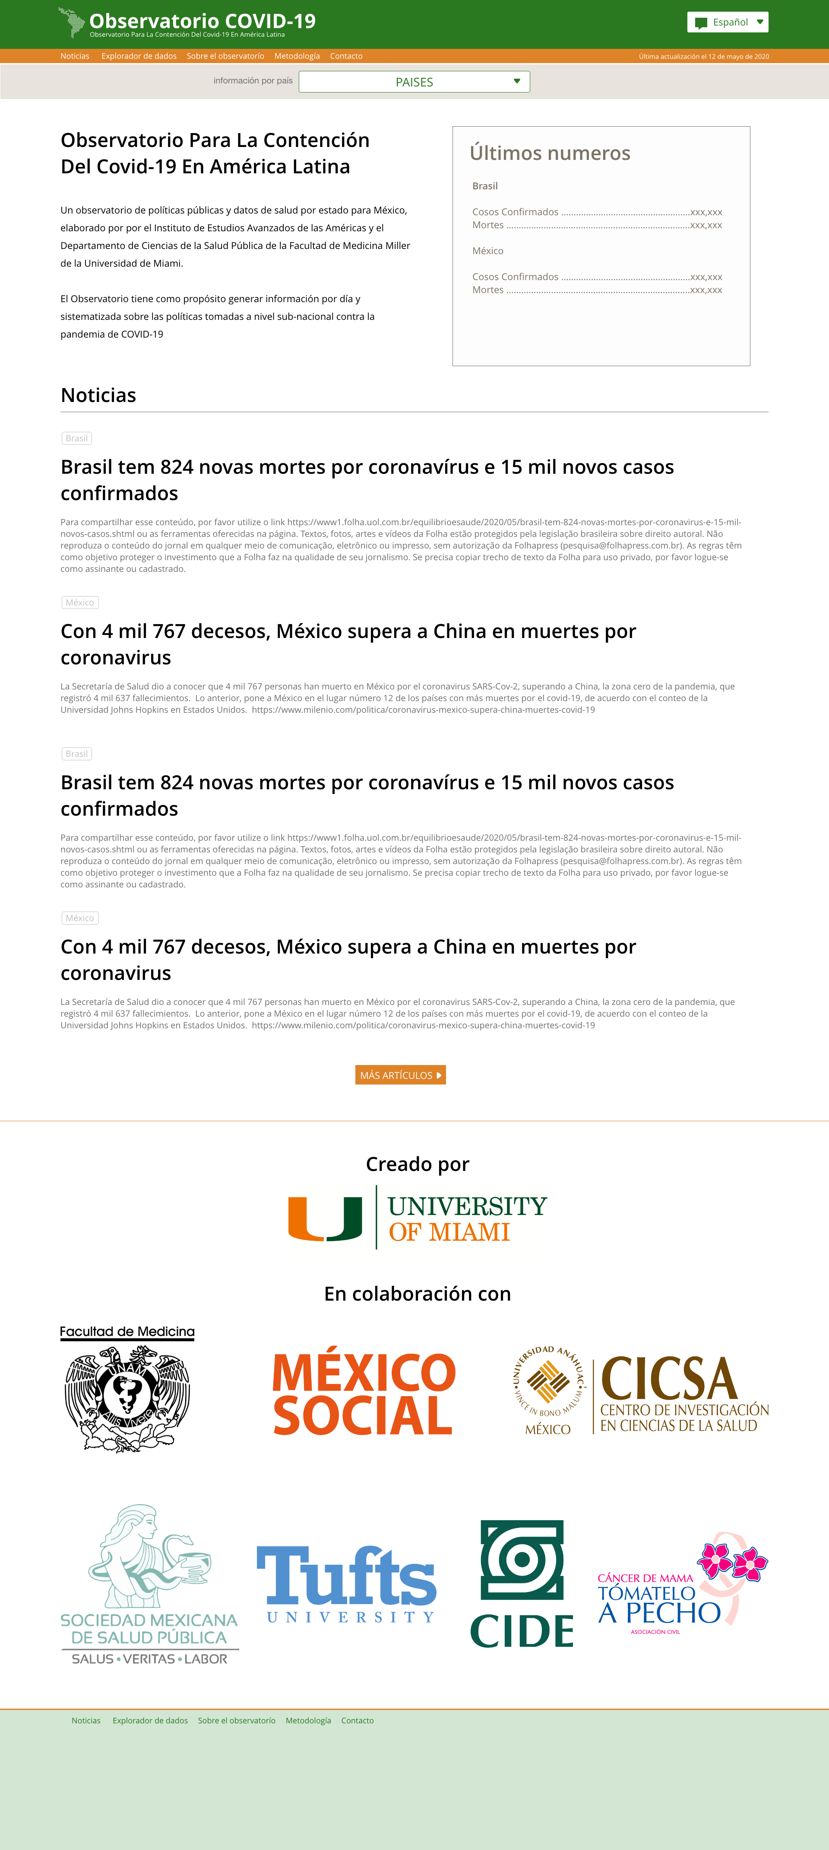
New website! ObservCovid.miami.edu

Slide 14
Observatory for the containment of COVID-19 in the Americas
In collaboration with:
June 2, 2020

